Slide 1

BANK MANAGEMENT SYSTEM
Submitted by,
Achal Gupta
Intern
Rapidcode Technologies Pvt. Ltd.

Slide 2
SOFTWARE DEVELOPERS
TEAM MEMBERS’
ACHAL GUPTA

Slide 3
OBJECTIVE
To develop a software for solving financial applications of a customer in banking environment. I
In order to FULFILL the needs of an end banking user by providing various ways to perform banking tasks.

Slide 4
REQUIREMENTS:-
USER REQUIREMENTS
SYSTEM REQUIREMENTS

Slide 5
USER REQUIREMENTS
BASIC KNOWLEDGE TO COMPILE PROJECT ON UNIX ENVIOURNMENT

Slide 6
SYSTEM REQUIREMENTS:-
SOFTWARE REQUIREMENT
FRONT END- C
Operating System – UNIX/LINUX

Slide 7
MODULE DESCRIPTION
MODULE | DESCRIPTION
Create Account | Creates a new account for the user accepting input as name.
Update Account | To update any information in the given account number
Log out | To sign out from the software

Slide 8
MODULE DESCRIPTION
Deposit | Provides option to deposit amount in the given account
Withdraw | Provides option to withdraw amount from given account number
Delete Account | Delete the selected account from bank
Display | Display the list of all account

Slide 9
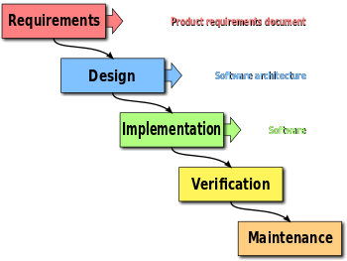
PROJECT MANAGEMENT

Slide 10
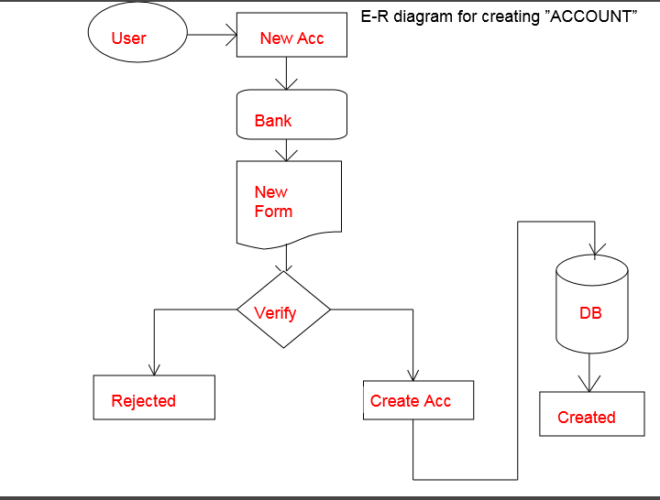
DATA FLOW DIAGRAM

Slide 11
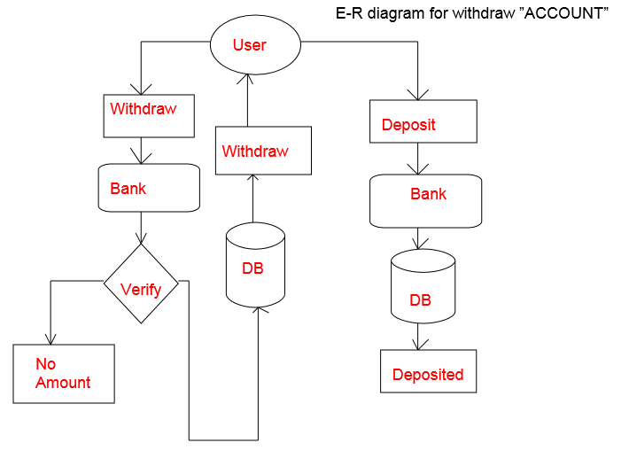

Slide 12
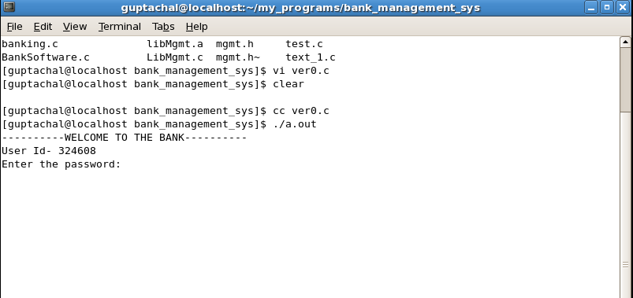
DESIGN AND SNAPSHOTS

Slide 13
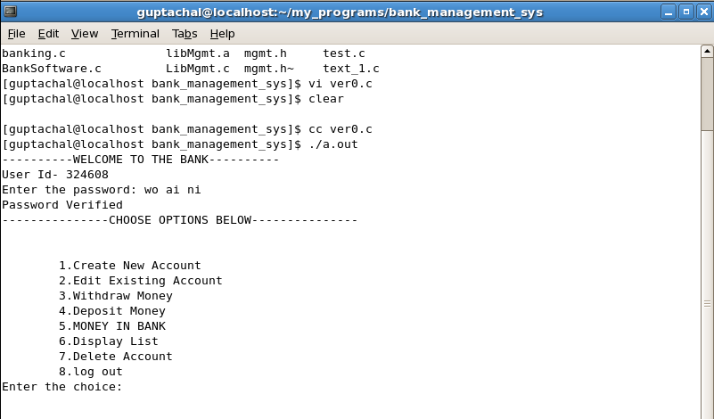
MID FROM

Slide 14
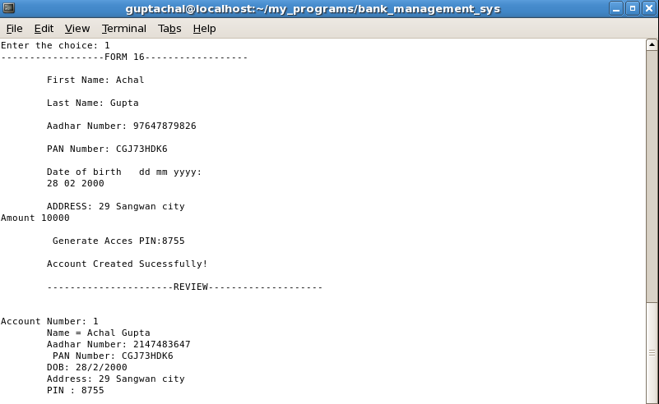
NEW ACCOUNT FORM

Slide 15
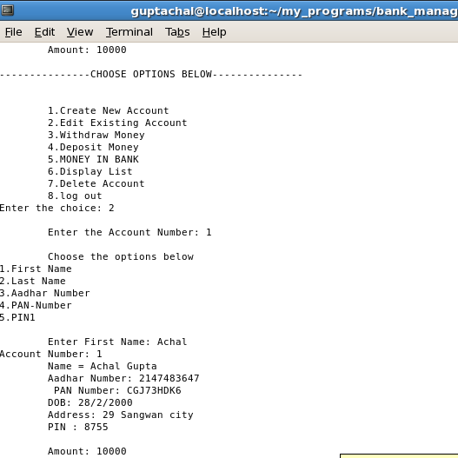
WITHDRAWL FORM

Slide 16


